Slide 1

ECEN 361
Real-Time and Embedded Systems
Real Time Operating Systems – Schedulers

Slide 2
Real Time Operating Systems
RTOS – Scheduler to Determine with Task to run
RTOS Normally Provides two additional Services
Semaphores
Shared Resource Protection
Synchronization
Queue Communications

Slide 3
Semaphores
A Semaphore is an object (data and functions) that provides two Services
Shared Resource Protection
Synchronization

Slide 4
Shared Resource Problem - Code Example
static int iTemperatures[2];
void interrupt vReadTemperatures (void)
{
iTemperatures[0] = !! read in value from HW
iTemperatures[1] = !! read in value from HW
}
void main (void)
{
int iTemp0, iTemp1;
while (TRUE)
{
iTemp0 = iTemperatures[0];
iTemp1 = iTemperatures[1];
if (iTemp0 != iTemp1)
!! Set off howling alarm;
!! Do other processing
}
}
Assume interrupt asserted at regular intervals, based on a timer, or when either temperature changes
What was the problem here?

Slide 5
Is the problem fixed?
static int iTemperatures[2];
void interrupt vReadTemperatures (void)
{
iTemperatures[0] = !! read in value from HW
iTemperatures[1] = !! read in value from HW
}
void main (void)
{
while (TRUE)
{
if (iTemperatures[0] != iTemperatures[1])
!! Set off howling alarm;
}
}

Slide 6
Consider the Assembly Language Sequence
static int iTemperatures[2];
void interrupt vReadTemperatures (void)
{
iTemperatures[0] = !! read in value from HW
iTemperatures[1] = !! read in value from HW
}
void main (void)
{
while (TRUE)
{
if (iTemperatures[0] != iTemperatures[1])
!! Set off howling alarm;
}
}
….
mov r1, (itemperatures[0])
mov r2, (itemperatures[1])
cmp r1, r2
je okay
; set off alarm
okay: ….
So, how could we solve this?

Slide 7
A Simple Solution
static int iTemperatures[2];
void interrupt vReadTemperatures (void)
{
iTemperatures[0] = !! read in value from HW
iTemperatures[1] = !! read in value from HW
}
void main (void)
{
int iTemp0, iTemp1;
while (TRUE)
{
disable Interrupt();
iTemp0 = iTemperatures[0];
iTemp1 = iTemperatures[1];
enableInterrupt ();
if (iTemp0 != iTemp1)
!! Set off howling alarm;
}
}
A Blackfin solution:

Slide 8
Shared Data
Defn - Critical Section: a section of code that cannot be interrupted for correct operation
Need to remember the shared data problem can arise when task code shares data or resources with ISR’s, or with other Tasks

Slide 9
Second Solution - Semaphores
Create a mutual exclusion semaphore to guard the resource.
Call semTake( ) before accessing the resource; call semGive( ) when done.
semTake( ) will block until the semaphore (and hence the resource) becomes available.
semGive( ) releases the semaphore (and hence access to the resource).

Slide 10
Creating Mutual Exclusion Semaphores
SEM_ID semMCreate (options)
options can be:
queue specification SEM_Q_FIFO or
SEM_Q_PRIORITY
deletion safety SEM_DELETE_SAFE
priority inheritance SEM_INVERSION_SAFE
Initial state of semaphore is available.
Notes:
Symbolic constants defined in semLib.h.
Queue specification determines the order in which tasks waiting for the semaphore should unblock.
Deletion safety and priority inheritance will be discussed later.

Slide 11
Mutex Ownership
A task which takes a mutex semaphore “owns” it, so that no other task can give this semaphore.
Mutex semaphores can be taken recursively.
The task which owns the semaphore may take it more than once.
Must be given same number of times as taken before it will be released.
Mutual exclusion semaphores cannot be used in an interrupt service routine.
Notes:
A mutex may be given regardless of ownership by calling the semMGiveForce( ) function. This is primarily intended as a debugging aid, but the function might be used in a recovery task if the task owning the mutex dies, and the resource guarded by the mutex can be reset to a consistent state.

Slide 12
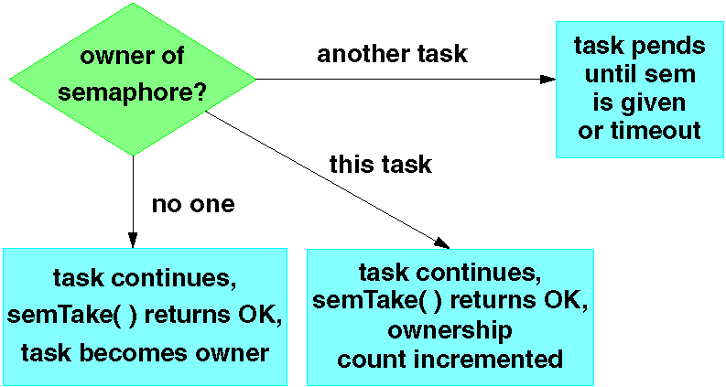
Taking a Mutex Semaphore
Notes:
Difference from binary semaphores:
Can be taken more than once by a task without blocking.

Slide 13
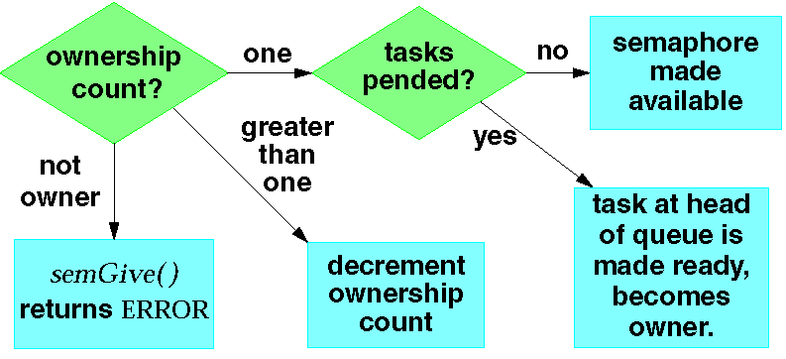
Giving a Mutex Semaphore
Notes:
Difference from binary semaphore:
Only the owner of a semaphore can give it.
The owner may take the semaphore more than once, but must give it as many times as it was taken in order to release it.

Slide 14
Code Example - Solution
1 #include “vxWorks.h”
2 #include “semLib.h”
3
4 LOCAL char myBuf[BUF_SIZE];/* Store data here */
5 LOCAL int myBufIndex = -1;/* Index of last data */
6 LOCAL SEM_ID mySemId;
7
8 void myBufInit( )
9 {
10 mySemId = semMCreate(SEM_Q_PRIORITY |
11 SEM_INVERSION_SAFE |
12 SEM_DELETE_SAFE);
13 }
14
15 void myBufPut (char ch)
16 {
17 semTake(mySemId,WAIT_FOREVER);
18 myBufIndex++;
19 myBuf[myBufIndex]=ch;
20 semGive(mySemId);
21 }

Slide 15
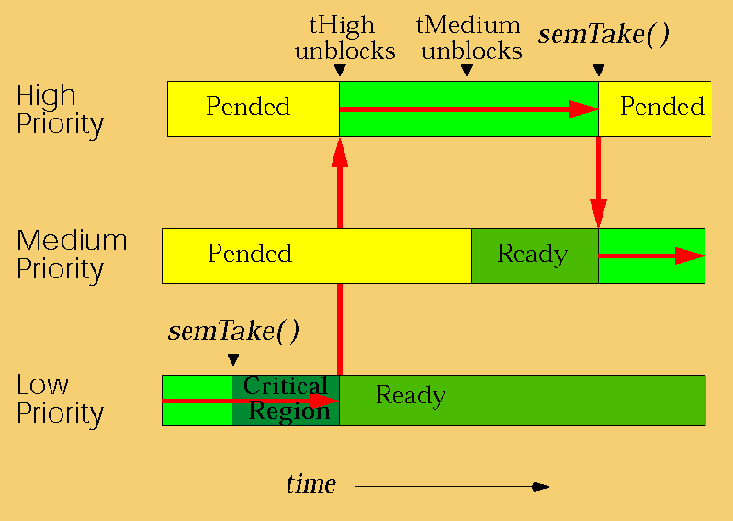
Unbounded Priority Inversion
Notes:
High and low priority tasks share a resource. Medium priority task has nothing to do with the resource whatsoever.
High-priority task blocks on a mutex semaphore held by low-priority task.
Can’t continue until low priority task calls semGive( ).
Critical region is short, so low-priority task will call semGive( ) soon if given a chance to run.
Low-priority task is preempted by medium-priority task, which is not involved in the mutual exclusion.
Low-priority task can’t complete its (very short) critical region.
This prevents the high-priority task from running.

Slide 16
Priority Inheritance
Priority inheritance algorithm solves the unbounded priority inversion problem.
Task owning a mutex semaphore is elevated to priority of highest priority task waiting for that semaphore.
Enabled on mutex semaphores by specifying the SEM_INVERSION_SAFE option during semMCreate( ).
Must also specify SEM_Q_PRIORITY (SEM_Q_FIFO is incompatible with SEM_INVERSION_SAFE).

Slide 17
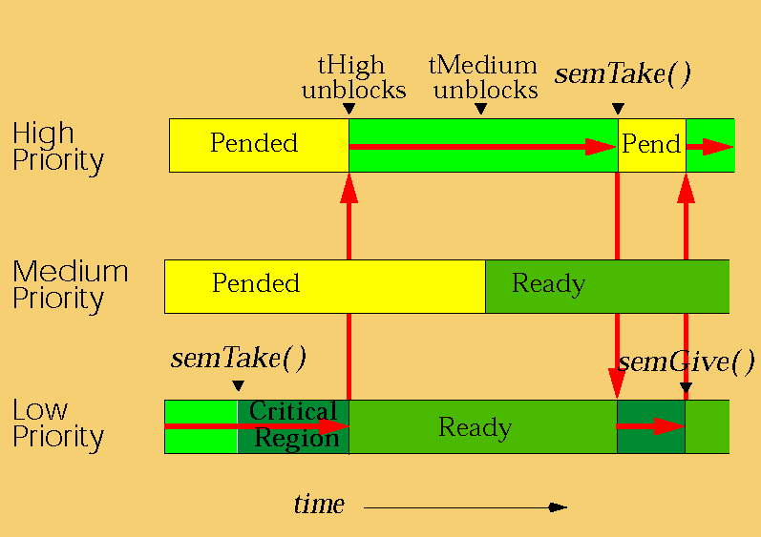
Priority Inversion Safety
Notes:
The low-priority task is allowed to finish its critical region at the same priority as the high-priority task.
The low-priority task returns to its original priority when it has given up all the inversion-safe mutexes which it owns.

Slide 18
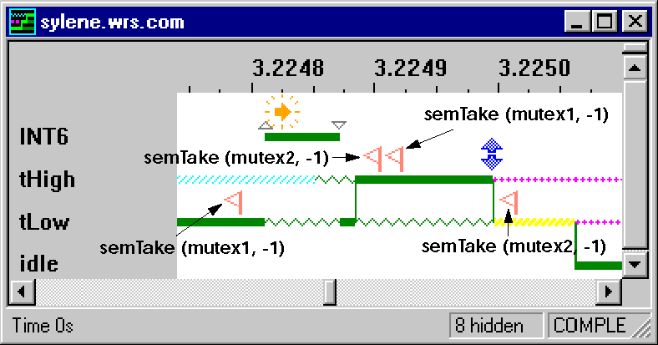
Caveat - Deadlocks
A deadlock is a race condition associated with the taking of multiple shared resources.
May be very difficult to detect during testing.
Notes:
Common solutions to potential deadlock situations:
Use only one semaphore to protect resources that will be accessed together.
Sequence accesses to resources. In above example, all tasks would take semId1 before attempting to take semId2.
In the WindView graph, note that WindView can distinguish between the time at which a blocking call to semTake() is logged, and the slightly later time at which the resulting context switch occurs. The above sequence takes not quite 300 μs on a 25 MHz 68k board. INT6 is the system clock interrupt level.

Slide 19
Deadlocks – Two Solutions
Move all the individual semaphores into a single semaphore
2) Enforce an order for taking semaphores
Notes:
Common solutions to potential deadlock situations:
Use only one semaphore to protect resources that will be accessed together.
Sequence accesses to resources. In above example, all tasks would take semId1 before attempting to take semId2.
In the WindView graph, note that WindView can distinguish between the time at which a blocking call to semTake() is logged, and the slightly later time at which the resulting context switch occurs. The above sequence takes not quite 300 μs on a 25 MHz 68k board. INT6 is the system clock interrupt level.

Slide 20
Other Caveats
Keep the critical region (code between semTake( ) and semGive( )) short.

Slide 21
Semaphores
Binary Semaphores and Synchronization – Used to pace a task
Notes:
What are semaphores?
How are they used

Slide 22
The Synchronization Problem
myGetData ( )
{
requestData( );
waitForData( );
getData( );
}
Task
Task may need to wait for an event to occur.
Busy waiting (i.e., polling) is inefficient.
Pending until the event occurs is better.

Slide 23
The Synchronization Solution
Create a binary semaphore for the event.
Binary semaphores exist in one of two states:
Full (event has occurred).
Empty (event has not occurred).
Task waiting for the event calls semTake( ) and blocks until semaphore is given.
Task or interrupt service routine detecting the event calls semGive( ), which unblocks the waiting task.

Slide 24
Taking a Semaphore
STATUS semTake (semId, timeout)
semId The SEM_ID returned from semBCreate( ).
timeout Maximum time to wait for semaphore. Value can be clock ticks, WAIT_FOREVER, or NO_WAIT.
Can pend the task until either
Semaphore is given or
Timeout expires.
Semaphore left unavailable.
Returns OK if successful, ERROR on timeout (or invalid semId).

Slide 25
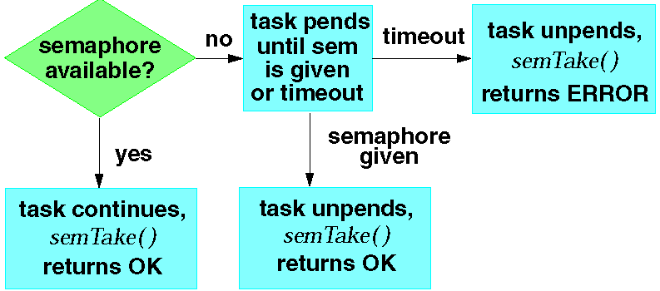
Taking a Binary Semaphore
Notes:
The semaphore is always left unavailable after a semTake( ).

Slide 26
Giving a Semaphore
STATUS semGive (semId)
Unblocks a task waiting for semId.
If no task is waiting, makes semId available.
Returns OK, or ERROR if semId is invalid.
Notes:
Unblocking a higher priority task will preempt caller of semGive( ).

Slide 27
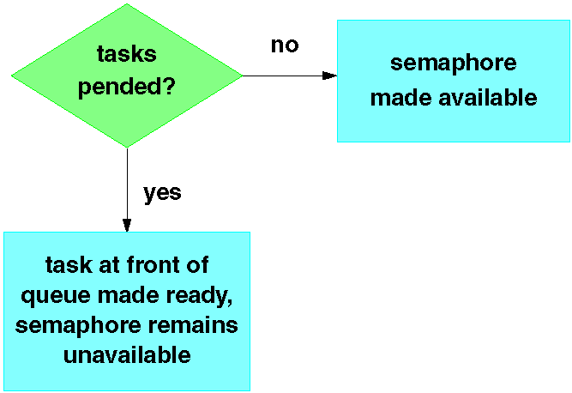
Giving a Binary Semaphore
Notes:
@ See the code example “Synchronization Solution” on page 2 of appendix A.

Slide 28
Synchronizing Multiple Tasks
STATUS semFlush (semId)
Unblocks all tasks waiting for semaphore.
Does not affect the state of a semaphore.
Useful for synchronizing actions of multiple tasks.
Notes:
This routine is not available for mutual exclusion semaphores.

Slide 29
What Does createSemphore() do?
Heap Memory
Processor
semaphore
readyQueue
1, 1, task1Function
2, 2, task2Function
0
PC = createSemaphore
task2RegisterState
Registers
task1RegisterState
blockedQueue
readyQueue
BIOS Variables
currentTask
0
task2Stack = task2Function
task1Stack
Creates a data Element (True/False)
main stack
blockedQueue
0
0
0
Stack Memory
Program Memory
task1Function()
{
while(1){
takeSemaphore(semaphore1);
getValue();
}
}
BIOS
main()
{ initRTOS();
createTask(1, task1Function);
createTask(2, task2Function);
createSemaphore(semaphore)
}
task2Function()
{ while(1)
getValue();
}
createSemaphore(semaphore)
{
}

Slide 30
What Does takeSemphore() do?
Heap Memory
Processor
semaphore
readyQueue
2, 2, task2Function
0
0
PC = takeSemaphore
task2RegisterState
Registers
task1RegisterState
blockedQueue
readyQueue
BIOS Variables
currentTask
0
task2Stack = task2Function
task1Stack
main stack
blockedQueue
1, 1, task1Function
0
0
Stack Memory
Program Memory
task1Function()
{
while(1){
takeSemaphore(semaphore1);
getValue();
}
}
BIOS
If semaphore is available – keep going
main()
{ initRTOS();
createTask(1, task1Function);
createTask(2, task2Function);
createSemaphore(semaphore)
}
task2Function()
{ while(1)
getValue();
}
If semaphore is taken – move process to blocked queue
createSemaphore(semaphore)
{
}

Slide 31
What Does giveSemphore() do?
Heap Memory
Processor
semaphore
readyQueue
1, 1, task1Function
2, 2, task2Function
0
PC = giveSemaphore
task2RegisterState
Registers
task1RegisterState
blockedQueue
readyQueue
BIOS Variables
currentTask
0
task2Stack = task2Function
task1Stack
main stack
blockedQueue
0
0
0
Stack Memory
Program Memory
task1Function()
{
while(1){
takeSemaphore(semaphore1);
getValue();
}
}
BIOS
interruptISP()
{
giveSemaphore();
}
main()
{ initRTOS();
createTask(1, task1Function);
createTask(2, task2Function);
createSemaphore(semaphore)
}
task2Function()
{ while(1)
getValue();
}
Changes state of semaphore
Moves from blocked to Ready Queue if task is waiting
createSemaphore(semaphore)
{
}

Slide 32
Interprocess Communication
Can be done using shared memory – In most RTOS all memory is available to all processes (in Linux – each process has its own memory space). A global shared memory space can be used to share information
No Information on when the data came in
Must be protected by a mutex semaphore

Slide 33
Interprocess Communication
A Queue is a more elegant solution.
Managed Data Structure
Data timing can be managed (FIFO/FILO)
Protects itself from multiple accesses
Can be used for synchronization

Slide 34
Queue: Task-to-task communication
Scope
How to create a queue
How a queue manages the data it contains
How to send data to a queue
How to receive data from a queue
What it means to block on a queue
The effect of task priorities when writing to and reading from a queue

Slide 35
Queue Characteristics – data storage
A queue can hold a finite number of fixed size data items.
Normally, used as FIFO buffers where data is written to the end of the queue and removed from.
Also possible to write to the front of a queue.
Writing data to a queue causes a byte-for-byte copy of the data to be stored in the queue itself.
Reading data from a queue causes the copy of the data to be removed from the queue.

Slide 36
A Queue is an Object
Queues are objects in their own right
Not owned by or assigned to any particular task
Any number of tasks can write to the same queue and any number of tasks can read from the same queue.
Very common to have multiple writers, but very rare to have multiple readers.

Slide 37
Blocking on Queue Reads
A task can optionally specify a ‘block’ time
The maximum time that the task should be kept in the Blocked state to wait for data to be available from the queue.
It is automatically moved to the Ready state when another task or interrupt places data into the queue.
It will also be moved automatically from the Blocked state to the Ready state if the specified block time expires before data becomes available.

Slide 38
Blocking on Queue Writes
A task can optionally specify a ‘block’ time when writing to a queue.
The maximum time that task should be held in the Blocked state to wait for space to be available on the queue.

Slide 39
Using a Queue
A queue must be explicitly created before it can be used.
The RTOS allocates RAM from the heap when a queue is created.
RAM holds both the queue data structure and the items that are contained in the queue.
xQueueCreate() API Function
Be used to create a queue and returns an xQueueHandle to reference the queue it creates.

Slide 40
Creating a Queue
Function Prototype
xQueueHandle xQueueCreate(
unsigned portBASE_TYPE uxQueueLength, unsigned portBASE_TYPE uxItemSize);
xQueueLength: The maximum number of items that the queue being created can hold at any one time.
uxItemSize: the size in bytes of each data item that can be stored in the queue.
Return Value:
if NULL is returned, the queue cannot be created as there is insufficient heap memory available for FreeRTOS to allocate the queue data structures and storage.
A non-NULL value returned indicates that the queue has been created successfully. It should be stored as the handle to the created queue.

Slide 41
Writing to a Queue
xQueueSendToBack()
Be equivalent to xQueueSend()
Be used to send data to the back(tail) of a queue
xQueueSendToFront()
Be used to send data to the front (head) of a queue
Please note, never call these two API functions from an interrupt service routine (ISR).
Interrupt-safe versions will be used in their place.

Slide 42
Reading from the Queue
xQueueReceive()
Be used to receive (consume) an item from a queue. The item received is removed from the queue.
xQueuePeek()
Be used receive an item from the queue without the item being removed from the queue.
Receives the item from the head of the queue.
Please note, never call these two API functions from an interrupt service routine (ISR).

